Slide 1


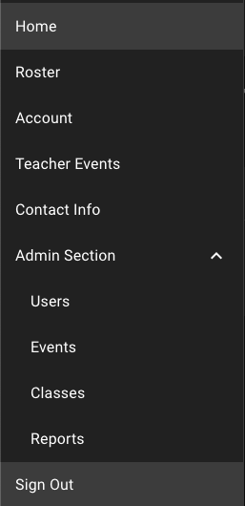
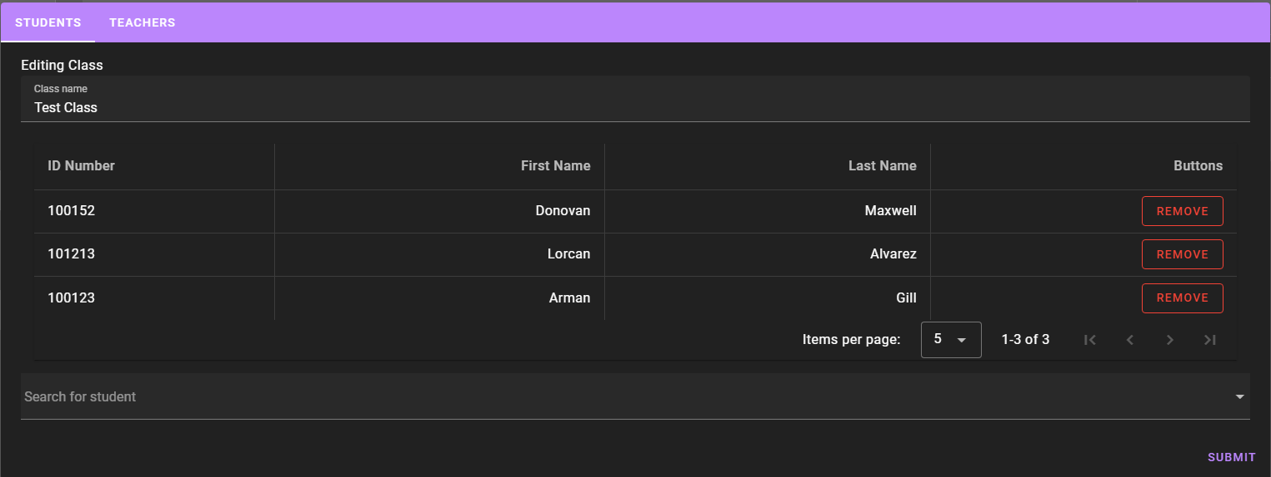
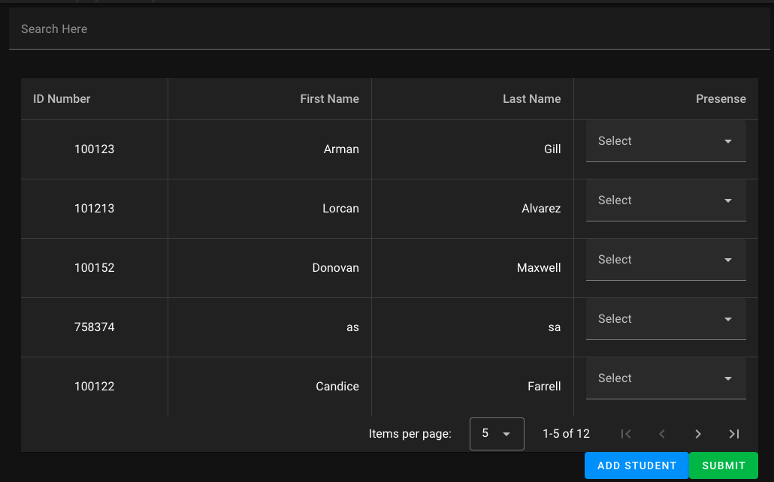
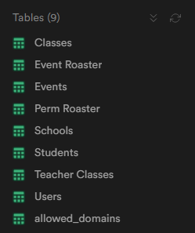
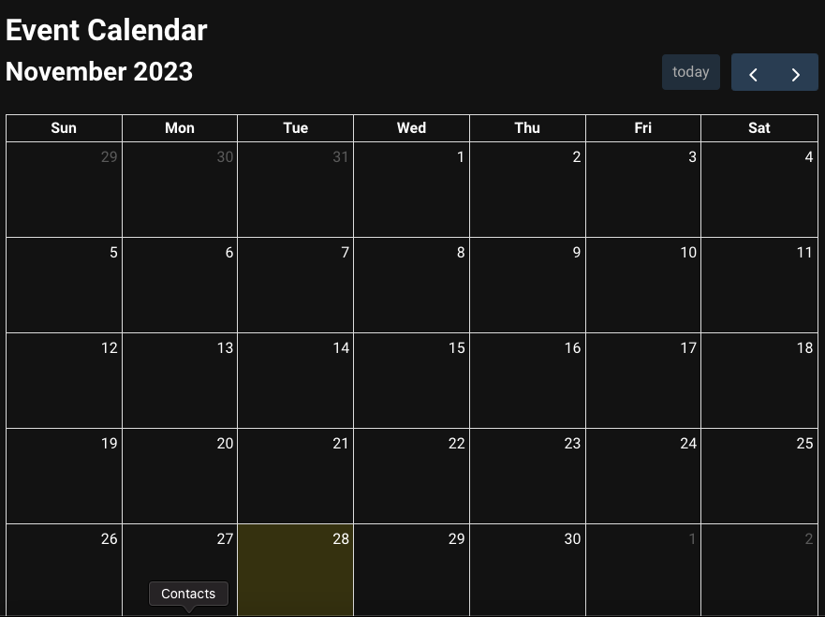
Emergency Class Manager
Katie Hoskins, Tanya Peacock, Marcus Stange
Dept. Of Computer Science and Information Technology
Abstract
Future Work
The Emergency Class Manager website is a web platform designed to simplify the process of collecting attendance during emergency situations or drills. The website is currently only to be used for CMCSS elementary schools. The website allows teachers a way to swiftly mark students present, absent, missing, or visiting during these events. Administration can make events or drills for a later date and teachers can easily view these events or drills on their dashboard. There is an easily accessible contact information page for quick emailing purposes to administration at a click of a button. The use of this website will streamline classroom response and give administration a clearer picture of students in the classroom, as well as giving them a place to keep reports of students and archives if needed.
In future updates on Emergency Class Manager, there will be a chat feature implemented so teachers can easily message each other as well as administration easily and right on the website instead of via email. We would also like to add a clickable event calendar for administration to automatically add events at the click of a button. We would also like to add a way for administration to upload their whole roster for the year and automatically import the students.
Background/Purpose
Currently, many of the schools in the Clarksville-Montgomery County School System use a simple spreadsheet to keep track of students. The spreadsheets are then emailed to administration to keep reports of the student's attendance during the emergency situations or drills. This allows for much more mistakes than the Emergency Class Manager does. This becomes a problem when a real emergency may arise. This method of keeping track of students is much slower and can cause issues if a teacher accidentally puts in an incorrect input. Incorrect input could result in a spiral of emails and correcting the spreadsheet.
Emergency Class Manager is meant to streamline and assist teachers in keeping track of their students instead of using the spreadsheet software. Teachers log into their account and are immediately greeted with the events for the day and can easily find their classes for when an event occurs, as well as being able to easily contact the administration if the need arises. The purpose of Emergency Class Manager is to assist both teacher and administrator in situations that a quick attendance check is needed and minimize misinputs for teachers in a user-friendly way.
Figure 1: Nav bar on sign in
Figure 2: Dashboard page for users upon sign in
Design
Upon entering the Emergency Class Manager website, the user is greeted with an info page about Emergency Class Manager and is able to sign in or register an account using a magic link via email. Once the user is signed in as a teacher, they are able to view the navigation menu and their dashboard with all events happening today. The user can view their account and change any information they need to. The user can navigate to the events calendar where they can view events coming up in the month ahead. The user can view their class roster and submit any information needed straight to administration. They can also view a contact page that contains the email for their school's administration and email them at the click of a button.
As administration, they can view all of this as well as the users list, classes list, and event calendar where they can create events.
Figure 3: Roster Page for teachers to take attendance
Figure 4: Tables used in Emergency Class Manager
References
VS Code: https://code.visualstudio.com/
Supabase: https://supabase.com/docs
Vue3: https://vuejs.org/guide/introduction.html
Vuetify: https://vuetifyjs.com/en/
Technology
Supabase is the core database used for the Emergency Class Manager. Supabase is an open-source substitute for Firebase that uses a full Postgres database, has built in sign-ups and logins. It also secures any data with row level security.
Vue3 is a versatile JavaScript framework for building web user interfaces. It is approachable, meaning that it is easy to adjust to meet the website’s needs. Vue3 builds on standard HTML and CSS with intuitive API.
Vuetify builds up from Vue3 and adds more components which help with website design.
Acknowledgements
We would like to thank Dr. Karen Meisch for her support of students in the College of Science, Technology, Engineering & Mathematics, and Dr. Leong Lee for his support of students in the Department of Computer Science and Information Technology. We would also like to thank Dr. John Nicholson for his support and guidance throughout this project.
Figure 5: Tables used in Emergency Class Manager

